Slide 1

How Healthy Is Your City?
Billy Fetzner
billfetzner@yahoo.com

Slide 2
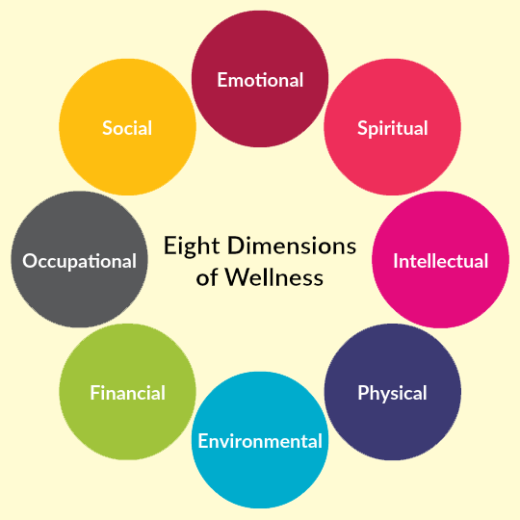
Agenda
Introduction
Importance
Data Source
Data Analysis
Machine Learning
Clustering
Classification
Conclusion/Call for Action!
This Photo by Unknown Author is licensed under CC BY-SA

Slide 3

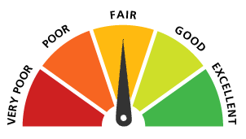
Introduction: Question
How does each city rank in terms of physical and mental health in comparison to other cities in the country?
This Photo by Unknown Author is licensed under CC BY-NC-ND

Slide 4
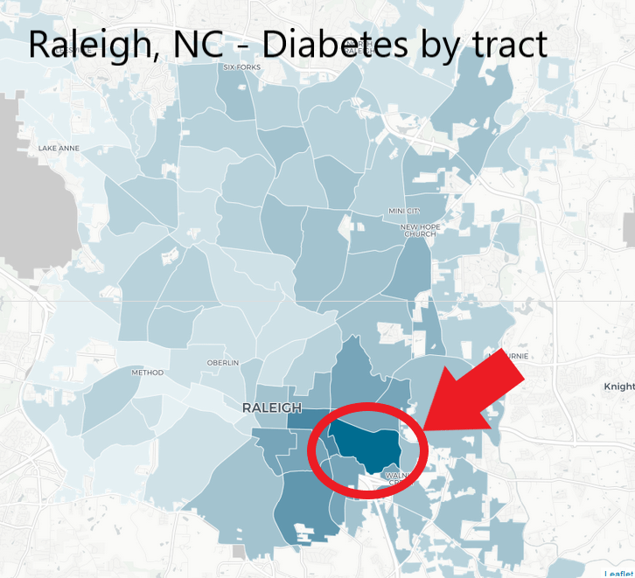
Why is this important?
Health officials
Municipalities where to focus resources
Possible Solutions:
Ranking of tracts and cities
Comparison of target city to cities that are ranked near that city
Implement any programs that closely ranked cities have already implemented so that target city can use these programs to increase their rank.
More resources in these areas

Slide 5
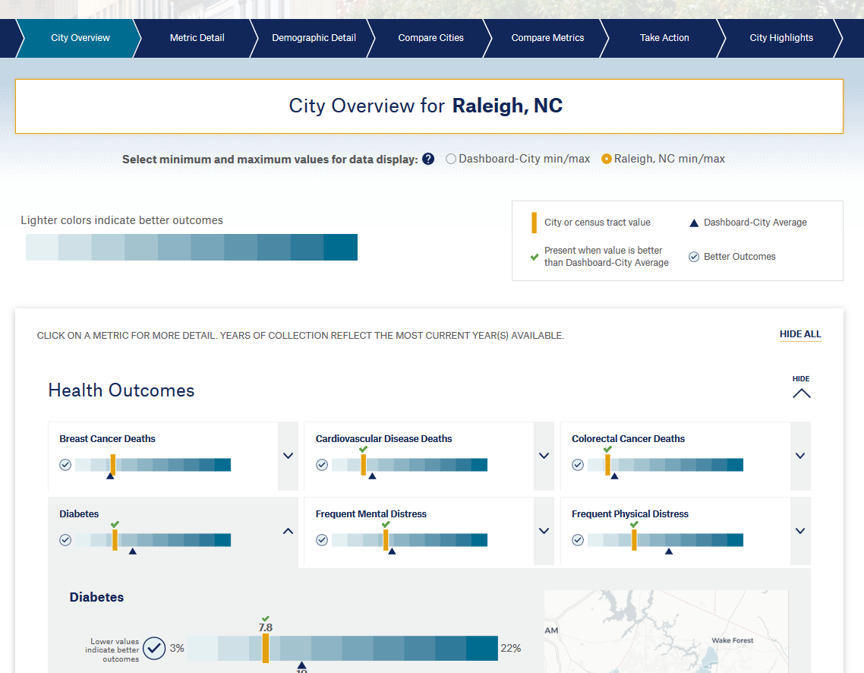
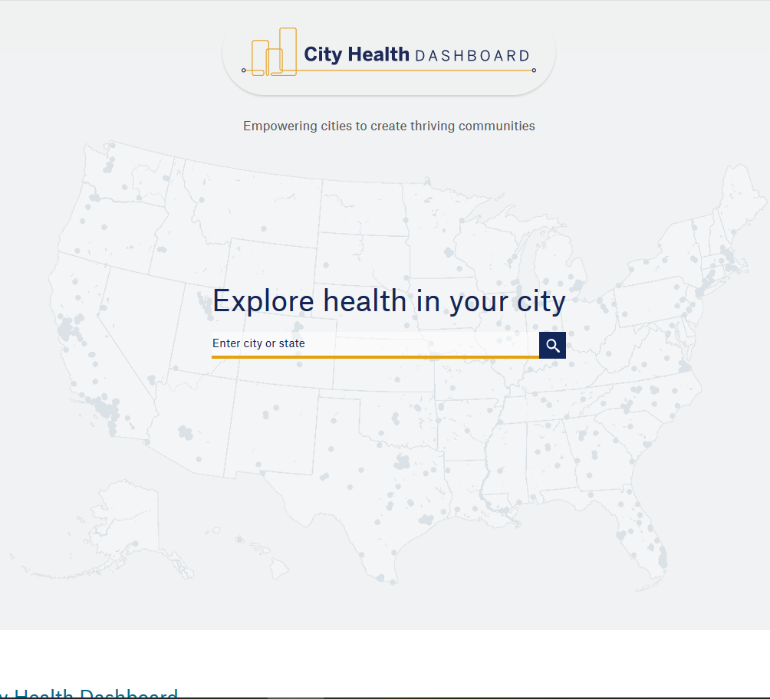
Data Source
City Health Dashboard
- City and Tract

Slide 6
Data Source
City Health Dashboard
City and Tract
Great Information:
Comparison of city to Dashboard city average and whether it is better or worse
Broken down by tract as well
Missing:
- Ranking and direct comparison between city and others with similar metric estimates

Slide 7
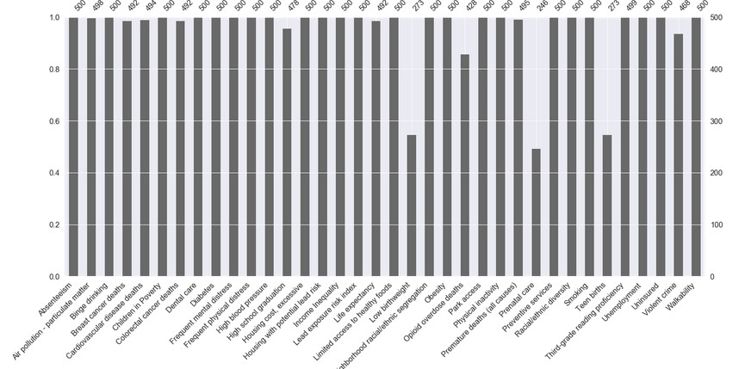
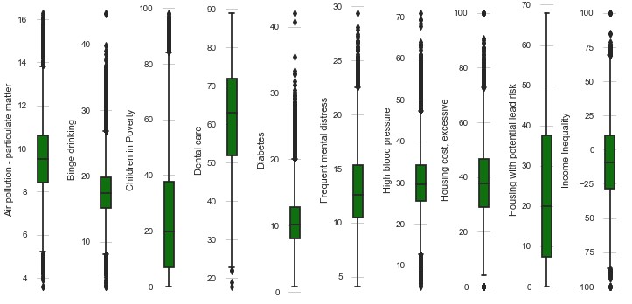
Data Analysis: Missing Data
Formatted data
metrics moved from a single column to its own column with values being the estimate of the metric for that city/tract
Iterative Imputer – dropped metrics with 50% missing values, imputed the remaining missing values
Outliers – removed cities that had more than one metric with an outlier

Slide 8
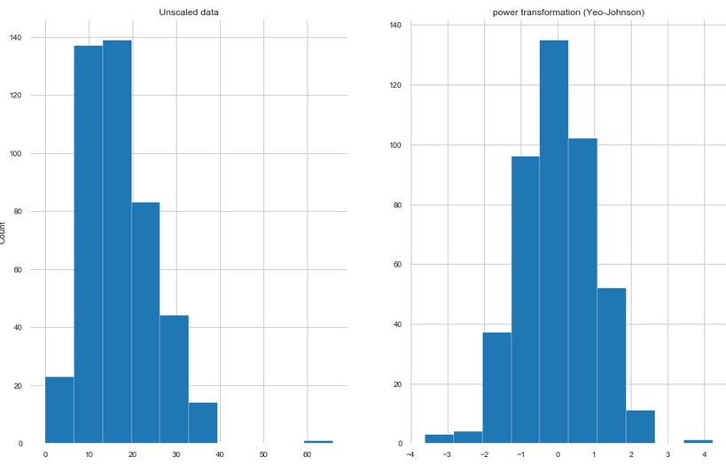
Data Analysis: Scaling
Tested for normality
Shapiro-Wilkes
D’Agostino’s
Transformations resulted in the highest number of normal metrics
City data
Power Transformation (Yeo-Johnson)
Tract data
Quantile Transformation

Slide 9
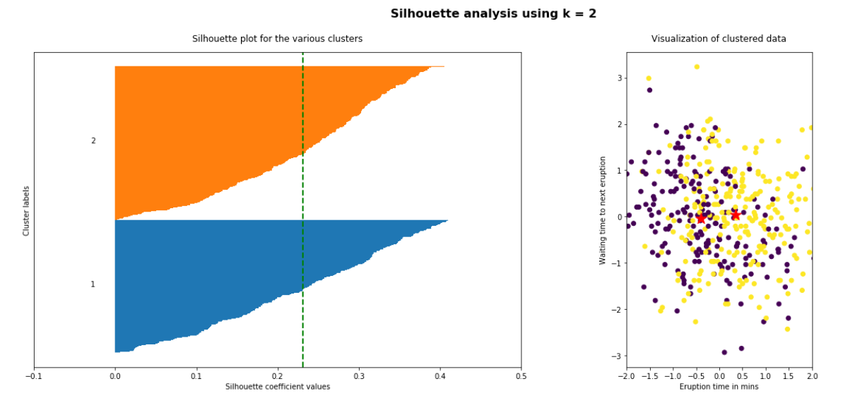
Machine Learning: Clustering
Cities/tracts did not come labelled as “healthy or unhealthy”
Clusterization needed to classify data and find which features were important
Tested several clustering methods
Best: Kmeans
Silhouette Analysis

Slide 10
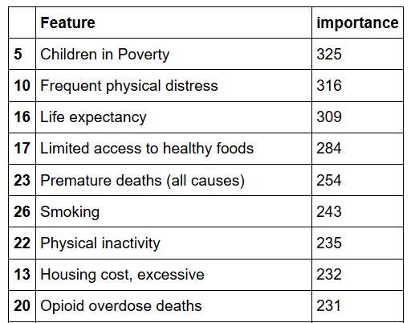
Machine Learning Classification
In conjunction with cluster labels from KMeans
Best Model: LightGBM
Received feature importance
for each metric
Gradient Boosting

Slide 11

Ranking
Scaled values
Sorted from healthiest to unhealthiest
Gave best city/tract rank of 1 -> 441 or 1 -> 26,848
Multiplied rank by feature importance as the “weight”
Resulted in a calculated score
Sorted with lowest score at the top
Gave each city/tract an overall rank based on score

Slide 12
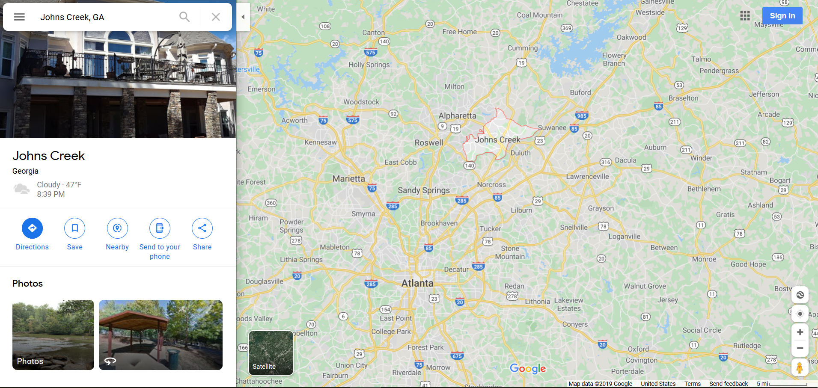
What is the Healthiest City?
John’s Creek, Georgia

Slide 13
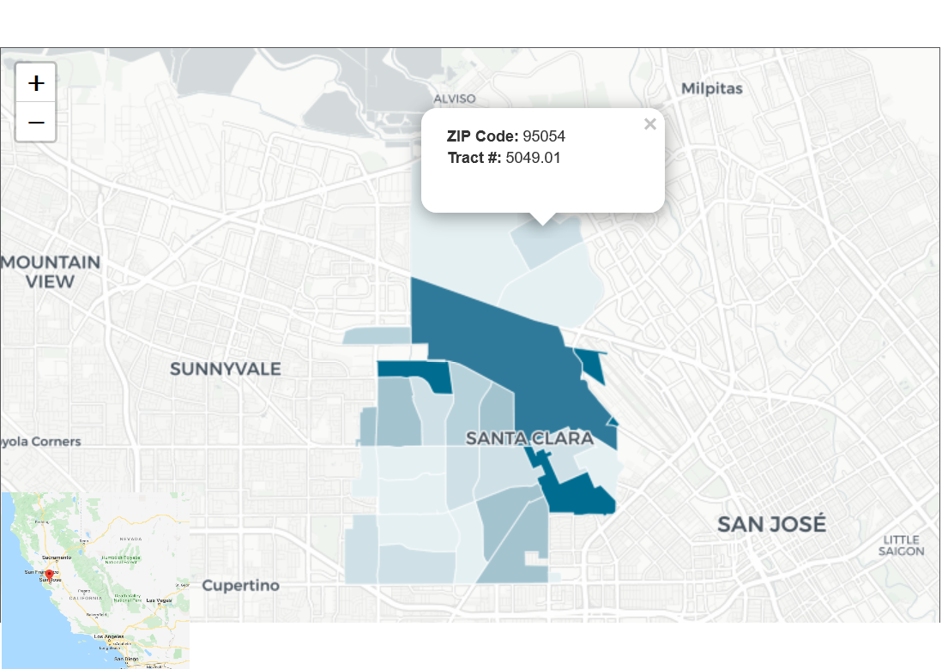
What is the Healthiest Tract?
Tract 5049.01 in Santa Clara, California

Slide 14
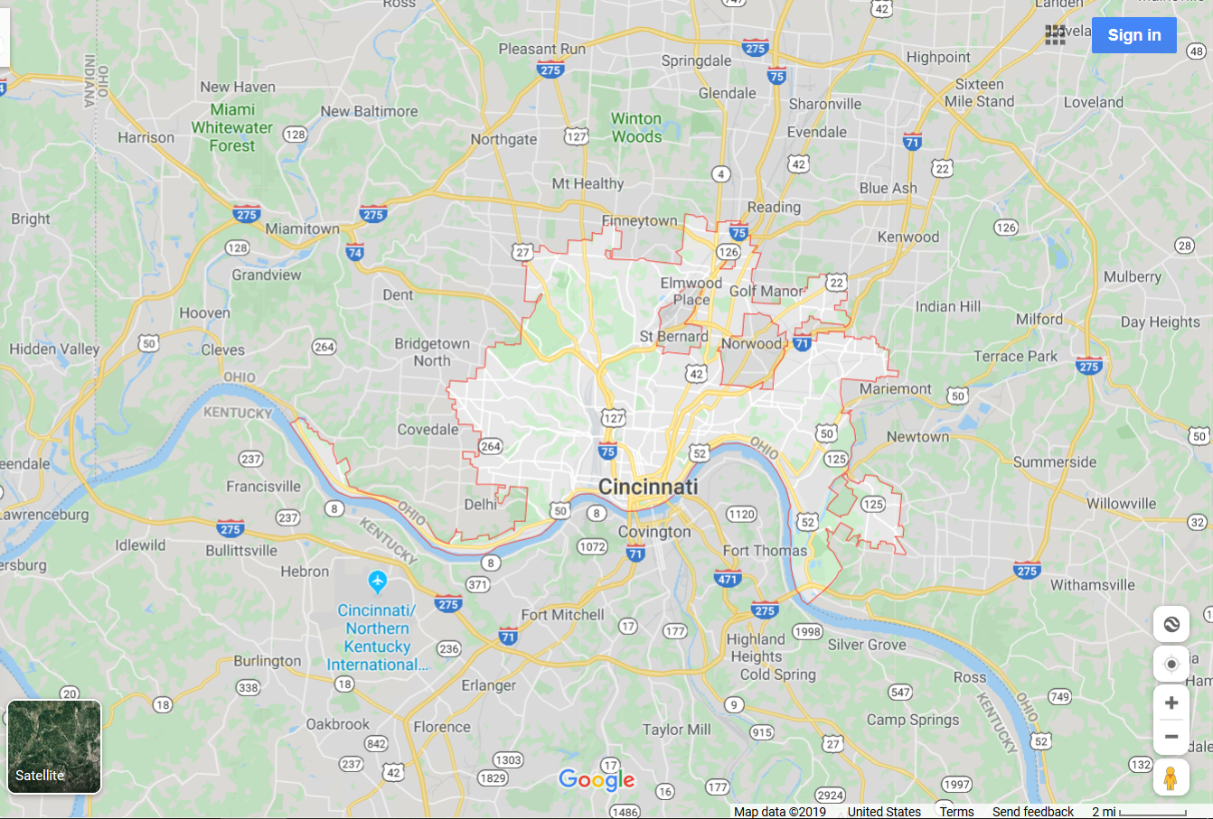
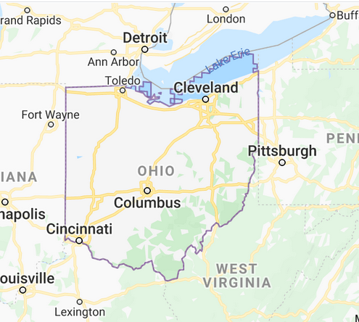
What is the Unhealthiest City?
Cincinnati, Ohio

Slide 15
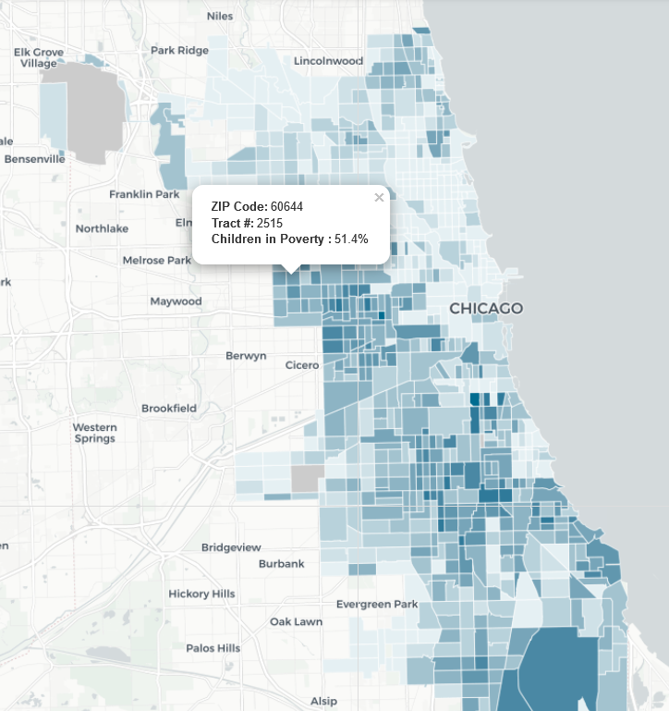
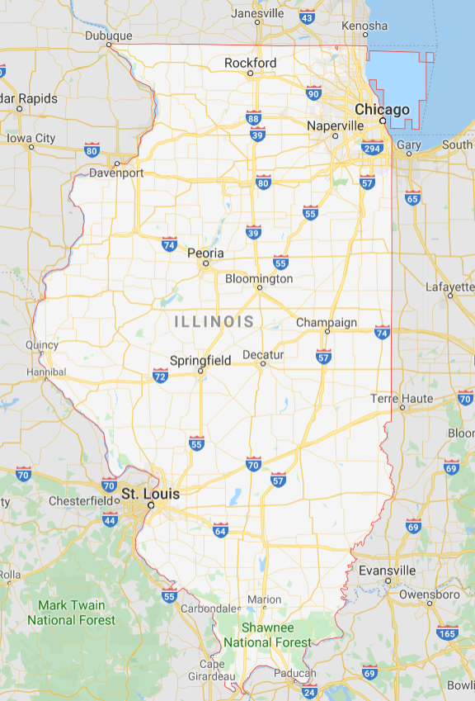
What is the Unhealthiest Tract?
Tract 2515.00 in Chicago, Illinois

Slide 16
Conclusion
Recommendations:
Find the cities that are ranked closest to your city, determine what metrics you would like to focus on, determine which cities ranked closest to your own are doing better/worse on those metrics and attempt to test out their programs
Additional research: extend to cities that are not on 500 cities dataset

Slide 17
Next Steps
Questions? – Contact me:
Billy Fetzner – billfetzner@yahoo.com
GitHub:
https://github.com/lilfetz22/Health_Scores_CAP2
Future Steps:
Machine learning that can take the demographics of any city, compare it to the cities in the 500 cities dataset, and determine the rank and health score of that city or census tract

Slide 18
Works Cited
City Health Dashboard
https://www.cityhealthdashboard.com/
CDC 500 Cities project
https://www.cdc.gov/500cities/index.htm
https://imaddabbura.github.io/post/kmeans-clustering/
https://github.com/Microsoft/LightGBM
https://www.analyticsvidhya.com/blog/2019/05/beginners-guide-hierarchical-clustering/
https://www.learndatasci.com/tutorials/k-means-clustering-algorithms-python-intro/
https://www.geeksforgeeks.org/clustering-in-machine-learning/

